Slide 1


Revving Up Innovation: Unleash the​ Power of GenAI for Insurance Claim Management​
Macquarie University PACE Program
3rd December 2024

Slide 2

Acknowledgement of Country
We acknowledge the Traditional Owners and Custodians of the land on which we meet today, the Gadigal People of the Eora Nation and pay my respects to their Elders both past and present, and emerging.

Slide 3
Agenda
Team Overview Slides 4 — 5
1
Problem Statement Slides 6 — 9
2
Project Workflow Slides 10 — 11
3
Options Analysis Slides 12 — 13
4
Data Pipeline Slides 14 — 17
5
6
AI Development Slides 18 — 24
7
Web App & Live Demo Slides 25 — 26
8
Realised Value Slides 27 — 28
9
Future Considerations Slides 29 — 30
10
Questions & Answers Slides 31 — 31

Slide 4

1
Team Overview
‹#›

Slide 5











Team Introduction
Noorullah Khan
EY Data Team Members
EY AI Team Members
Noorullah Khan
Role: Project Manager, Lead Data & SWE
Degree: BIT (Data Science)
Akriti Nangia
Role: Project Manager
Degree: BIT (Cyber Security)
Ninuri Mahagoda
Role: Business Analyst, Data Engineer
Degree: B.Com & BIT (Info Systems)
Ngoc Nguyen
Role: Software Engineer
Degree: BIT (CSE)
Tashiya Vilathgamuwa
Role: Business Analyst & Data Engineer
Degree: B.Com & BIT (Info Systems)
Eugene Sung
Role: Software Engineer
Degree: B.Com & B.Eng (Hons) SWE
Aasnayem Gazzali Chowdhury (Adam)
Role: Data Engineer & Modeller
Degree: BIT (Data Science)
Daniel Blaxland
Role: Software Engineer
Degree: BIT (Software Tech)
Alan Nguyen
Role: Solutions Architect
Degree: BIT (Data Science)
Mingxin Yang
Role: Business Analyst
Degree: BIT (Cyber Security)
Chenhao Guo
Role: Quality Tester
Degree: BIT (Data Science)

Slide 6

≈
2
Problem Statement
‹#›

Slide 7




Problem Statement
Ninuri Mahagoda
The EY AI & Data team has been approached by NRMA Insurance with the goal of simplifying their claims process and uplifting their fraud detection capabilities using GenAI | Create a high quality dataset that will be used to train the AI model ensuring results with high accuracy. The data must include: Anonymised personal information Vehicle history Incident description | Develop a GenAI model that will ingest data and provide an outcome of the veracity of the claim. The outcome of the model must be accurate and simplifies the current claims process. | Design a WebApp that allows the claims officer to efficiently examine automobile claims and determine whether the claim was fraudulent or not.

Slide 8



Business Requirements
Ninuri Mahagoda
GenAI Solution: The problem should be addressed using some form of Generative AI
Use Azure Services: EY is a Microsoft partner and would like you to use Azure Services
Anonymised Data: Data should be stripped of PII. For example, name, address, mobile phone etc.
User Interface: The solution should have a front-end element that the claims manager interacts with.
Agile Delivery: The project should follow the iterative Agile delivery method.
Notes:
Problem statement + BR = 1 min 55 seconds

Slide 9




Revolutionise Processes
Eugene Sung
Current Process
Source: Claims In A Digital Era: Data, analytics and AI transform the customer experience, EY, May 27, 2017
Divide & Classify
Validate Data
Submit Decision
2
4
6
1
3
5
File Review
Extract Info
Understand Data
New GenAI Process
“
Ask AI
Submit Decision
Gradual decrease in claims officer dependency.
1
2
3
4
“
Receive Claim
Review & Validate Claim

Slide 10

≈
3
Project Workflow
‹#›

Slide 11
Workflow (Agile Methodology)
Tashiya Vilathgamuwa
Creation of Epics
Divided Tasks into Epics, representing our main strategic goals
Proof of Concept
How do we create it?
Establish blueprints, guardrails, and high level solution designs
4
3
Design & Requirements
Outline the high level design and requirements of the solution
2
Agile Sprints
What are we actually developing?
Breakdown of user stories and activities to achieve outlines deliverables and milestones
Test
Does it work?
5
Define
What are we trying to do?
Define the problem statement, scope, issues and challenges
1
Backlog
Sequenced activities or capabilities to be built or implemented
Repeat
Notes:
Agile = 1 min 5 seconds

Slide 12




Sourcing Raw Data
Ninuri Mahagoda
Industry Research
2. User Stories
Systems/methods in use in other companies/countries
NRMA’s current fraud detection capabilities
Common fraudulent behaviors in the insurance sectors
Perspective of the AI team and NRMA as the the client
Outline the specific needs of the users of the dataset
4. Kaggle Dataset
3. Key Data Features
Offers one of the largest, most reputable collections of open source datasets
Finalised 3 key sources
Must contain a fraud label column
Must contain Australia relevant details

Slide 13

≈
4
Options Analysis
‹#›

Slide 14
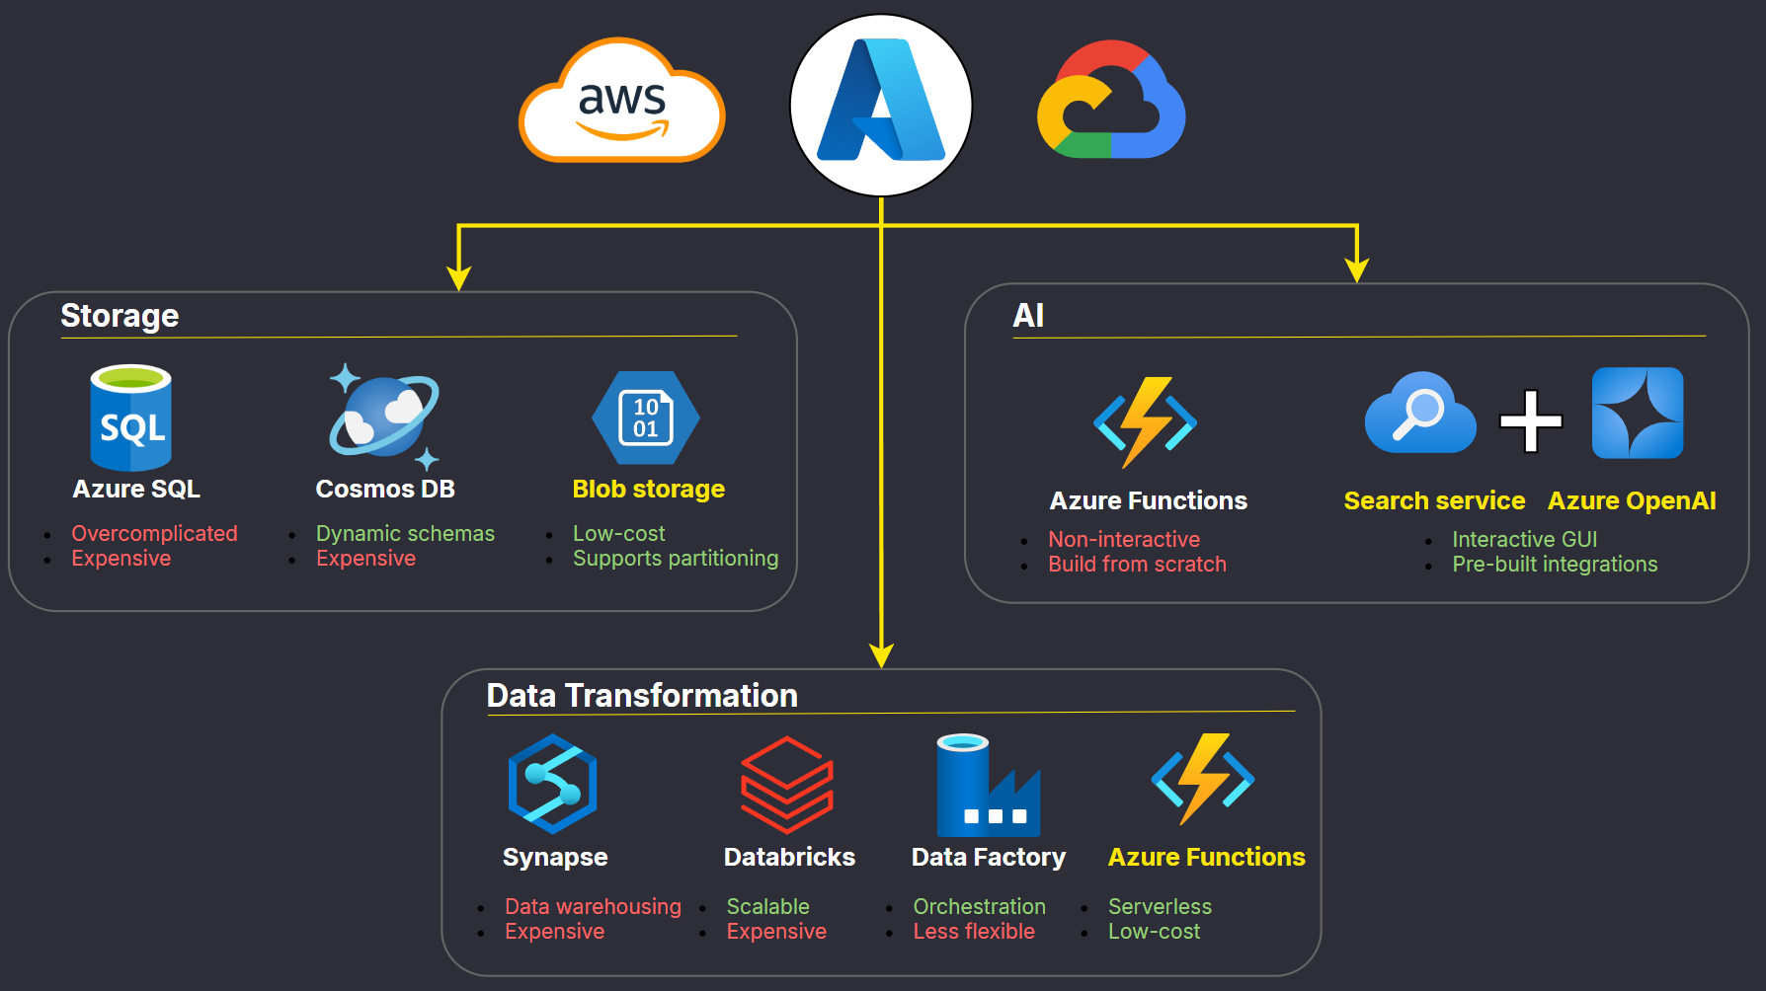
Options Analysis
Alan Nguyen
Notes:
Given our partnership with Azure and NRMA’s existing data platform running on it, it puts Azure as a natural leading choice, yet I think it’s still important to understand why Azure is appropriate for this project. One, being that Azure has a deep integration with the current Microsoft’s ecosystem which many of us already use and second is its hybrid cloud capabilities which is highly regarded in the industry will allow us to store sensitive data on premise while still leverage the power of the cloud.
Now, for storage, we selected to run a data lake on Azure Blob Storage over AzureSQL and CosmosDB due to it being low-cost and appropriate to store a flat dataset as required. For data transformation, we opted for Azure Functions over the other options as they provide unnecessary functions making them more expensive. And finally on the AI front, choosing Azure Functions means building a solution from scratch which time-consuming and unreasonable for an MVP so we choose a combination of Azure Search Service to index the data and azure openAI to train the LLM interactively.
Now, let’s hear from Ninuri on how we gather our data.

Slide 15

≈
5
Data Pipeline
‹#›

Slide 16
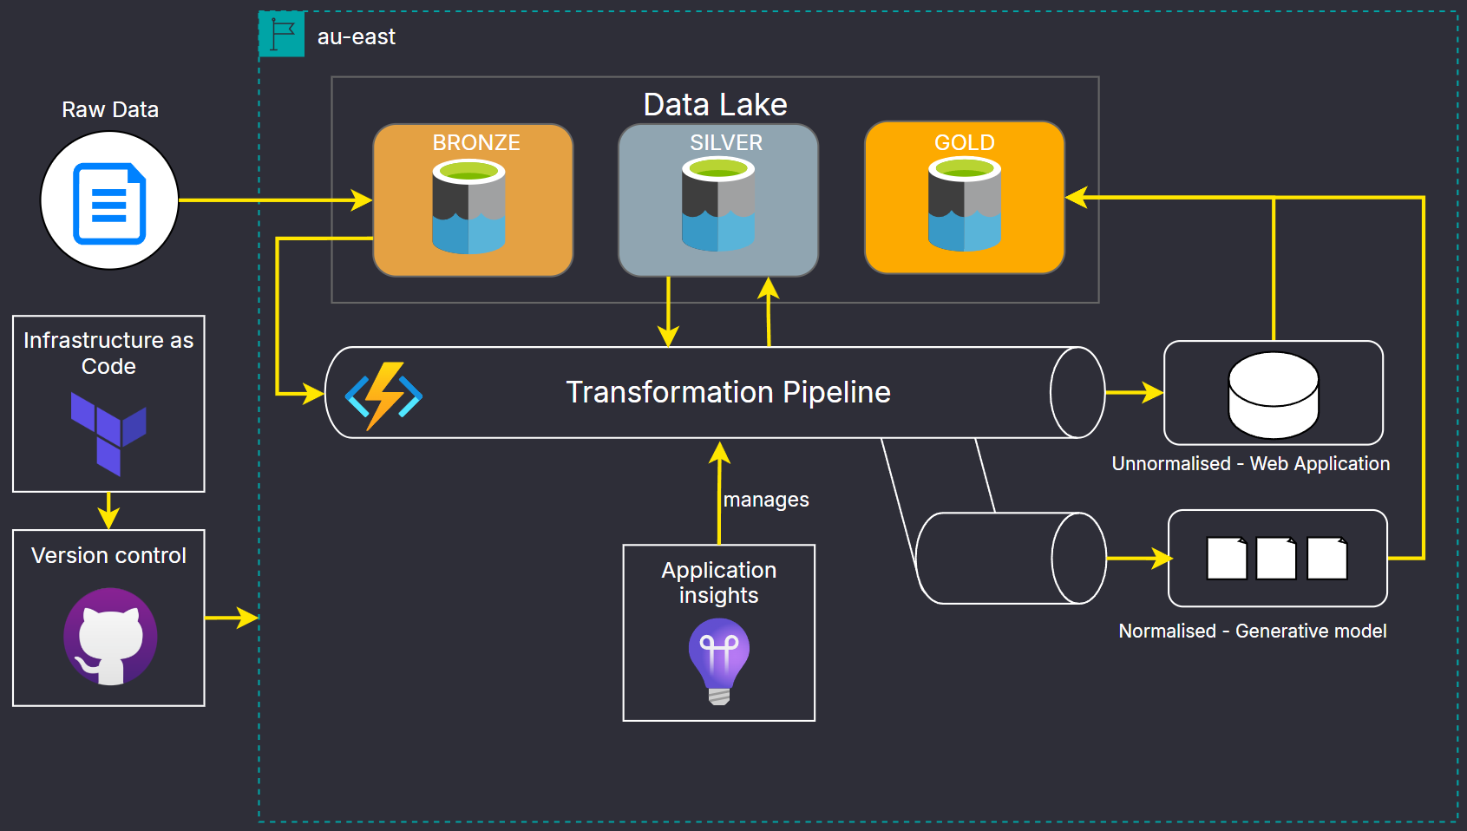
Infrastructure
Alan Nguyen
Notes:
With data gathered from many different sources, we must first store it in the Bronze layer inside this Datalake designed in the Medallion Architecture which abstracts our data into 3 layers to help with data governance. Then through each transformations with Azure Functions, the data will be stored in the Silver layer until it is ready for consumption in the Gold layer. 1 set of data will be send the the web application and the same but normalised set of data will be used to train the LLM.
Besides from that, in order to adapt to the agile workflow of constant changes, we look to use Terraform to build our infrastructure as code which allow us to easily manage the infrastructure as well as flexibly changing it when required. Also, with the help of Github Actions, we were able to build a CI/CD pipeline to remove all of the manual work when pushing a new infrastructure or changes to the transformation scripts. Not to mention the Application Insights that we use here to keep track of the pipeline health.

Slide 17
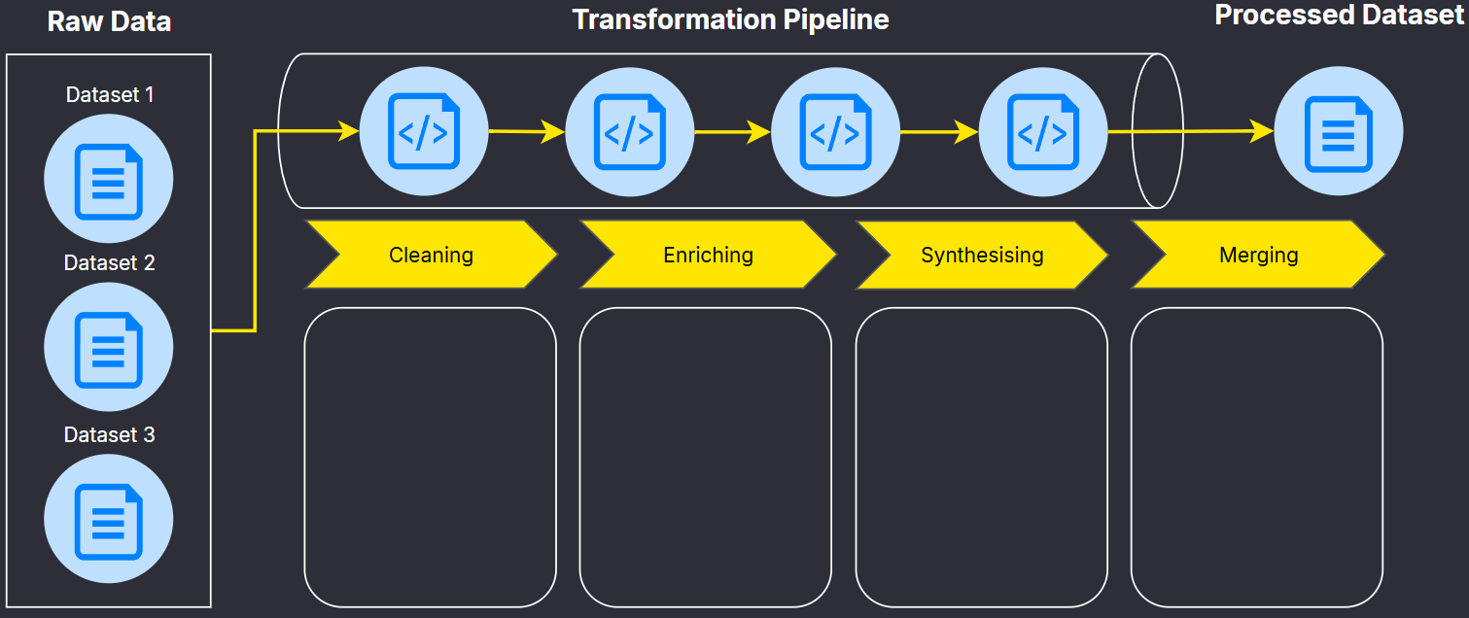
Data Transformation Pipeline
Aasnayem Chowdhury
Missing values handled
Columns renamed using camelCase
Data Standardisation
Column creations
Unwanted
columns dropped
Conversion of categorical
columns to
numeric
2 methods used:
Remapping and Mathematical Sampling
CTGAN (Generative Adversarial Network)
3 Original Datasets
2 Synthetic Datasets
Index identifier
Fraud column
Merged Dataset: 20,877 rows
Notes:
Data transformation = 1min 34sec
Missing values handled
Columns renamed using camelCase
Data Standardisation

Slide 18

6
AI Development
‹#›

Slide 19





High Level Solution Design
Daniel Blaxland
Optimisation
Prompt Engineering
Storage
User Interface
Cleaned Data
Website Application
Process
Integration
AI
API Key

Slide 20
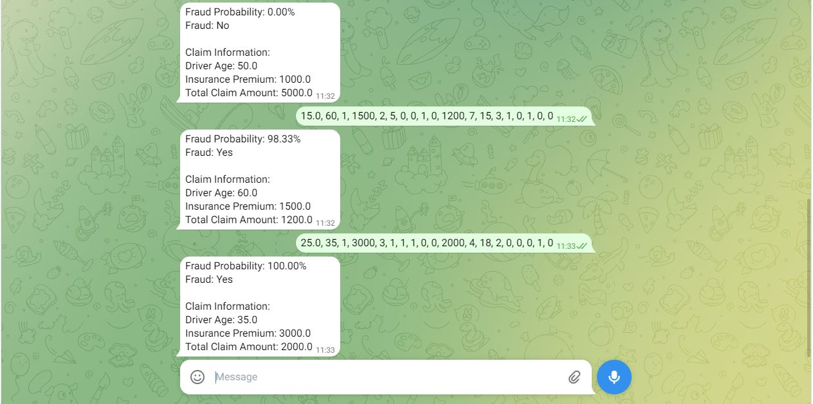
Telegram Integration
Daniel Blaxland

Slide 21




Evaluation Metrics
Daniel Blaxland
Evaluation
Accuracy
Precision
Recall
F1-Score
~80%
Overall Accuracy
~60%
False Positives
~30%
False Negatives
~50%
Balance of Precision and Recall

Slide 22
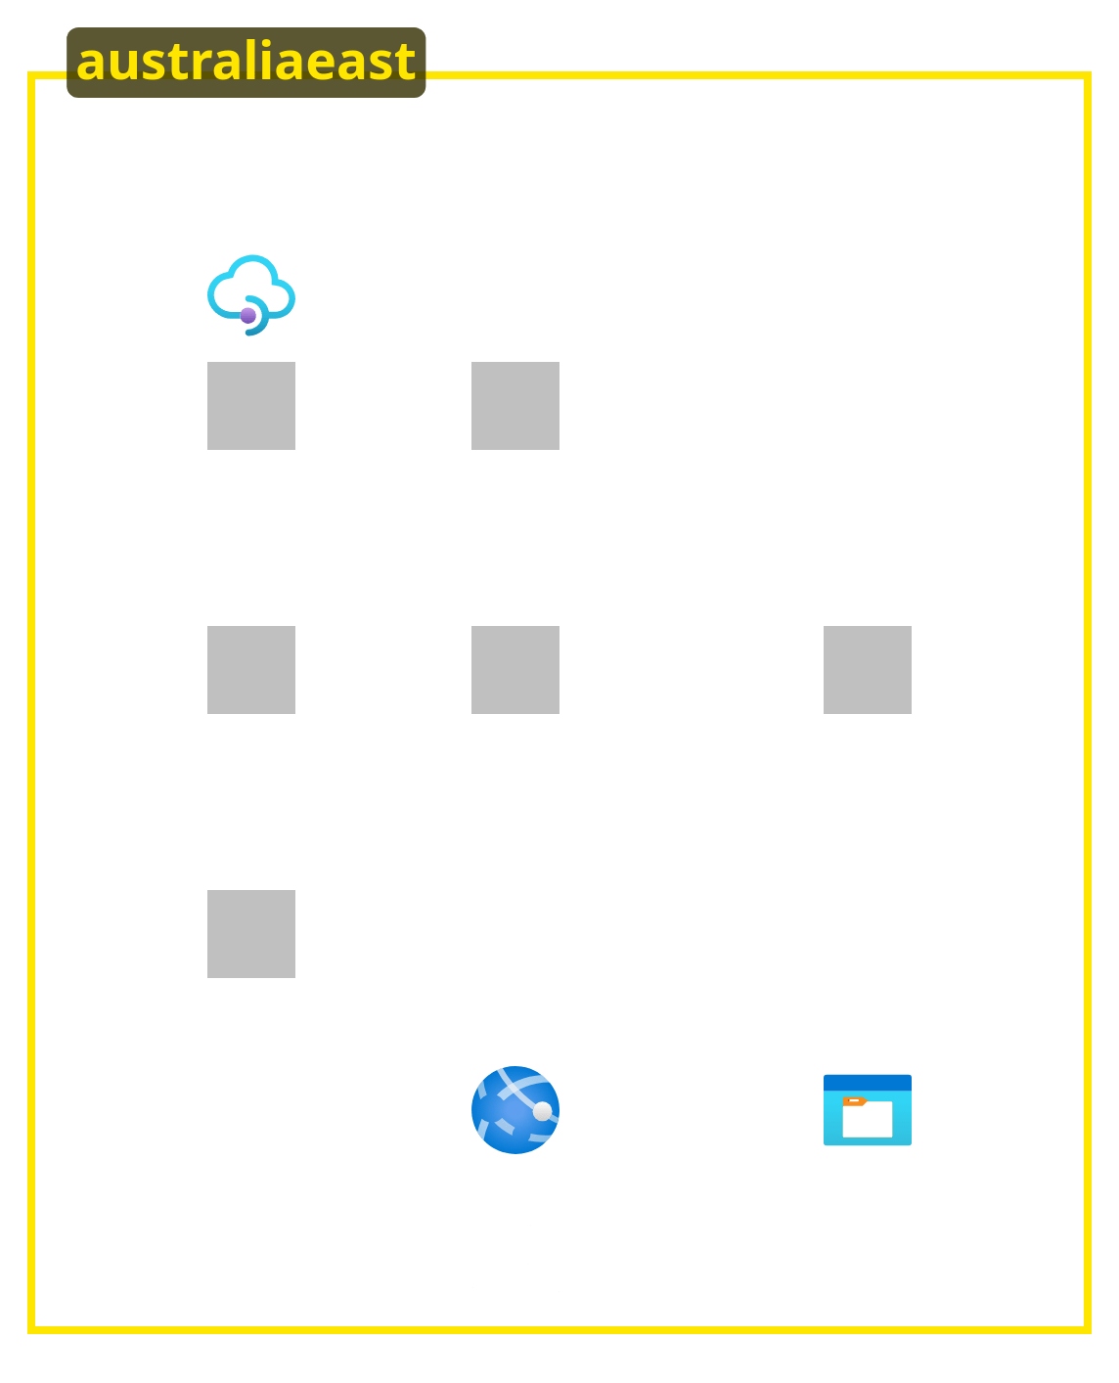







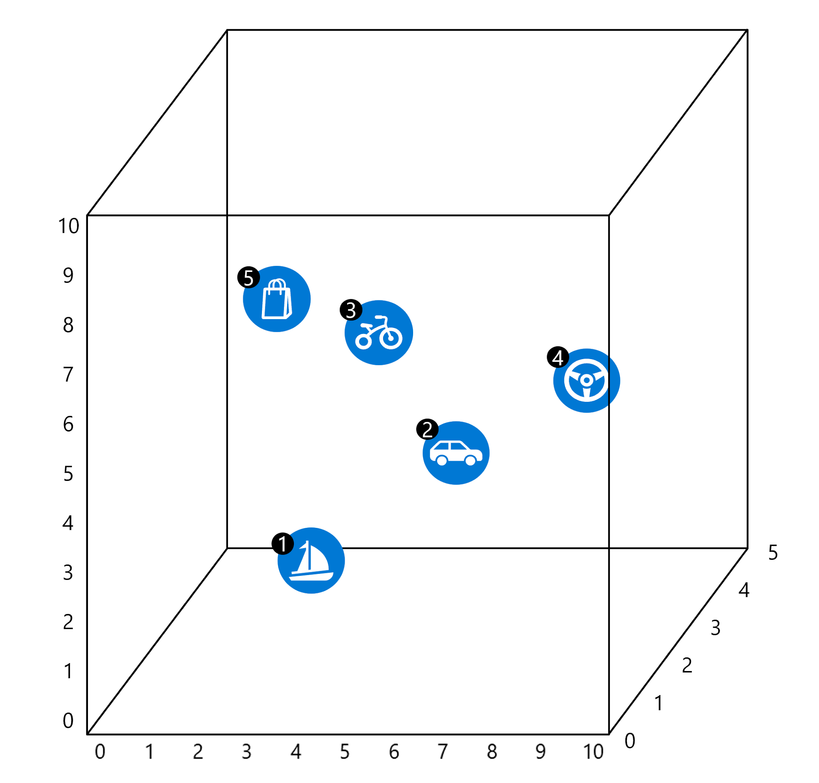

Azure Architecture
Eugene Sung
Key Components & Tailoring for NRMA
Feeding the AI with proprietary and accurate datasets will allow a tailored and enhanced system for NRMA.
Tokenization is pivotal in translating the user query into a language that GPT-4o-mini can interpret.
Semantic search enables complex queries and understands the context beyond the individual words.
The cosine similarity formula allows data to be retrieved from PDFs and CSV files.
AI Studios
Key Vault
AI Search
GPT-4o-mini
OpenAI
Text Embedding
Web App
Blob Storage
Claims Officer

Slide 23
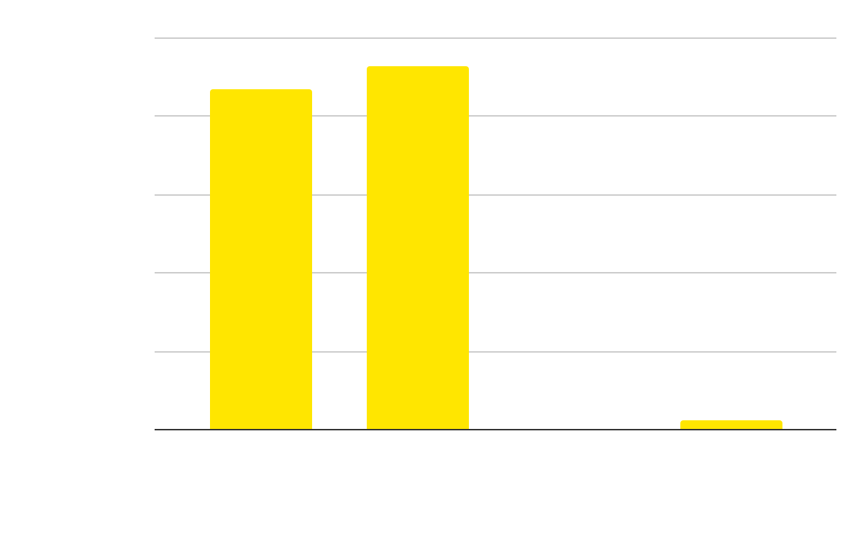
AI Application
Eugene Sung
AI Use Case in Insurance Claims
Cost Breakdown
Use Case
FRAUD DETECTION
CLAIMS MANAGEMENT
PRICE OPTIMISATION
FASTER ONBOARDING
• Assign fraud likelihood for an insurance claim.
• Explains the factors for how the AI assigned the % of fraud on an insurance claim.
• Uniform platform for processing and settling insurance claims.
• Enhanced risk assessments.
• Personalised pricing based on non-risk individual behavioral data and market competition analysis.
• Answer questions that new hires may have.
• Retrieve definitions and processes from the NRMA Policy Booklet.
$0.01
Details
Operating cost of the AI is A$227.79 per month or A$9.54 per day (subject to ± A$8.00 depending on usage).
Evaluation
Factor Weighting
Source: Model Selection, OpenAI, n.d.
The AI prioritises the total requested claim payout in relation to police reports and if authorities were involved.
Long-time customers have a moderate positive correlation, indicating a slightly increase the likelihood of fraud.
87%
98%
1.7%
70%
Accuracy Rate
Factual Consistency
Hallucination Rate
Temperature

Slide 24





Transformation
Eugene Sung
Key Success Factor
Source: GenAI Will Write the Future of Insurance Claims, BCG, Dec 13, 2023
Responsible AI Principles
Protecting NRMA’s IP & Data
Data & Technology Readiness
People Change Management
“
With the time reduction, employees can dedicate their time to higher-value activities and help reduce employee burnout caused by repetitive activities.
Source: The human side of generative AI: Creating a path to productivity, McKinsey & Company, Mar 18, 2024
“

Slide 25

7
Web App & Live Demo
‹#›

Slide 26
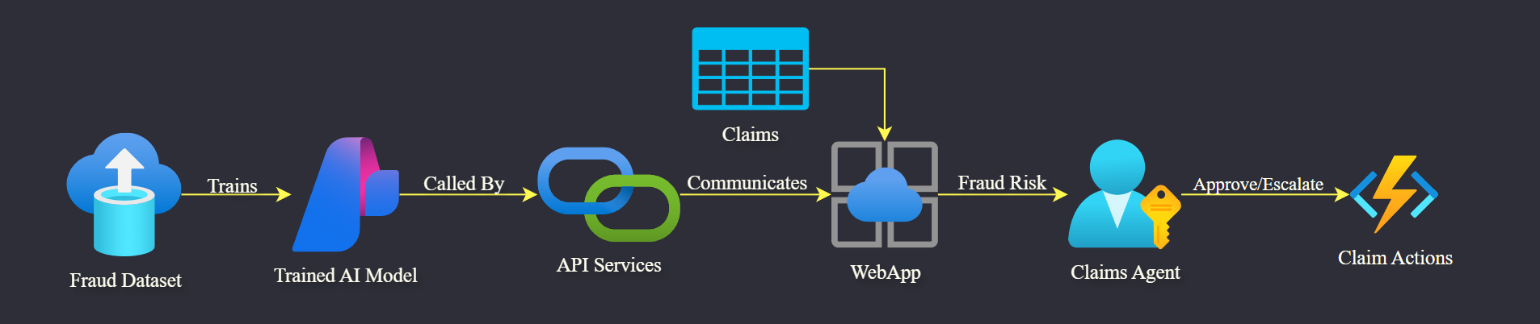

WebApp Integration + Live Demo
Noorullah Khan

Slide 27

8
Values
‹#›

Slide 28



Values
Tashiya Vilathgamuwa
Value for NRMA Claims agents
Efficiency: Reduces repetitive tasks, enhancing role impact.
Meaningful Work: Focus on flagged claims and faster resolution.
Accuracy: 87% fraud detection accuracy minimizes false positives.
Insights: Tools like "Explain More" and "Ask AI" enable better decisions.
Value for the organisation
Cost Savings: Fraud costs Australian insurers $400M annually—30% reduction unlocks significant reinvestment.
Customer Satisfaction: Speeds up resolution of legitimate claims.
Strategic Impact: Positions NRMA as a trusted, innovative leader.
Future Growth: Fuels reinvestment in innovation and service.
1
1
2
¹ Insurance Council of Australia, Insurance industry boosts fight against fraud and scams, 2023
GoodData, How Shift Technology has saved millions for insurance companies with analytics, 2024
2
Notes:
¹ Insurance Council of Australia, Insurance industry boosts fight against fraud and scams, 2023, available at: https://insurancecouncil.com.au/resource/insurance-industry-boosts-fight-against-fraud-and-scams/
GoodData, How Shift Technology has saved millions for insurance companies with analytics, 2024, available at: https://www.gooddata.com/resources/shift-technology-case-study/

Slide 29

9
Future Considerations
‹#›

Slide 30
Future Considerations
Alan Nguyen
Data Transformation Scaling
AI Cost Optimisation
Consider Databricks for scaling
Distributed data processing
Tight integration with ML workflows
Explore building a RAG app from scratch
Save cost on not using fully managed services
01
02
Expanding Project Scope
Web Application Dashboard
Build an Intelligent Document Processing system
LLM-integrated OCR technology
04
03
Develop a dashboard to summarise claims processing data
Improve Claims Managers decision-making
More in Appendix
More in Appendix
Notes:
Looking ahead, one key consideration is to start exploring a distributed data processing system like Databricks to help us handle larger incoming data more efficiently
To optimise costs on the AI front, we could explore building a RAG app from scratch on Azure Functions by transitioning away from fully managed services which tend to be more expensive.
We also see value in developing a web application dashboard to enhance visibility into claims processing. This dashboard would provide claims managers with real-time insights, helping them make more informed decisions.
Finally, we could start developing an Intelligent Document Processing system which is an improvement on the current OCR technology powered by LLMs to automate extraction, interpretation and organisation of data from more dynamic data format.

Slide 31
Questions & Answers
Noorullah Khan
Alan Nguyen
Ninuri Mahagoda
Eugene Sung
Tashiya Vilathgamuwa
Daniel Blaxland
Aasnayem Gazzali Chowdhury

Slide 32
Thank You

Slide 33
Appendix

Slide 34
Team Introduction
Noorullah Khan
NRMA
EY Data Team
EY AI Team
Tashiya Vilathgamuwa
Role: Business Analyst & Data Engineer
Degree: B.Com & BIT (Info Systems)
Noorullah Khan
Role: Project Manager, Lead Data & Software Engineer
Degree: BIT (Data Science)
Akriti Nangia
Role: Project Manager
Degree: BIT (Cyber Security)
Daniel Blaxland
Role: Software Engineer
Degree: BIT (Software Tech)
Eugene Sung
Role: Software Engineer
Degree: B.Com & B.Eng (Hons) SWE
Alan Nguyen
Role: Solutions Architect
Degree: BIT (Data Science)
Aasnayem Chowdhury(Adam)
Role: Data Engineer & Modeller
Degree: BIT (Data Science)
Ninuri Mahagoda
Role: Business Analyst, Data Engineer
Degree: B.Com & BIT (Info Systems)
Chenhao Guo
Role: Quality Tester
Degree: BIT (Data Science)
Mingxin Yang
Role: Business Analyst
Degree: BIT (Cyber Security)
Ngoc Nguyen
Role: Software Engineer
Degree: BIT (CSE)

Slide 35
Timeline - Sprint & Epic Planning
July 2024
August 2024
September 2024
October 2024
November 2024
Sprint | Sprint 1 | Sprint 2 |  | Sprint 3 |  | Sprint 4 |  | Sprint 5 |  | Sprint 6 |  | Sprint 7 |  | Sprint 8 |  | Sprint 9
Week # | W0 | W1 | W2 | W3 | W4 | W5 | W6 | W7 | W8 | W9 | W10 | W11 | W12 | W13 | W14 | Wk15 | Wk16
Program Delivery
Introduction
Begin Building
Cloud and UI Development
Testing and Final Product
Project Kickoff Meeting
MVP 1 Presentation
MQ Final Presentation
EY Final Presentation
Introduction 1
Begin Building 1
Begin Building 2
Finalise Building 1
Finalise Building 2
Deployment 1
Deployment 2
Testing 1
Finale 1
Key:
Milestone
Notes:
Draft high level solution design – to be done in session
Draft technical requirements
Project draft timeline & budget
Excel breakdown of work
Epics are already on the board
Under epic I want user stories
Under user stories I want tasks
Week 1 – create all user stories
Week 2 – PM/PL/End User/PO – rank user stories in order of development

Slide 36

Synthesising Methods - In Detail
Generated
4000 rows each
Remaps & mathematically samples data
Method
Method
Neural Network learns complex patterns in data
Minimal resources & computation
Efficiency
Method 1
Method 2
Efficiency
Efficient with complex data
Remapping and Mathematical Sampling
CTGAN:
Generative Adversarial Networks
Preserves Values of `Fraud` Column
Validity
Validity
Captures complex `Fraud` relationships
Good, Quick & Efficient Data Generation
Quality
Quality
Realistic, High Quality Data Generation

Slide 37
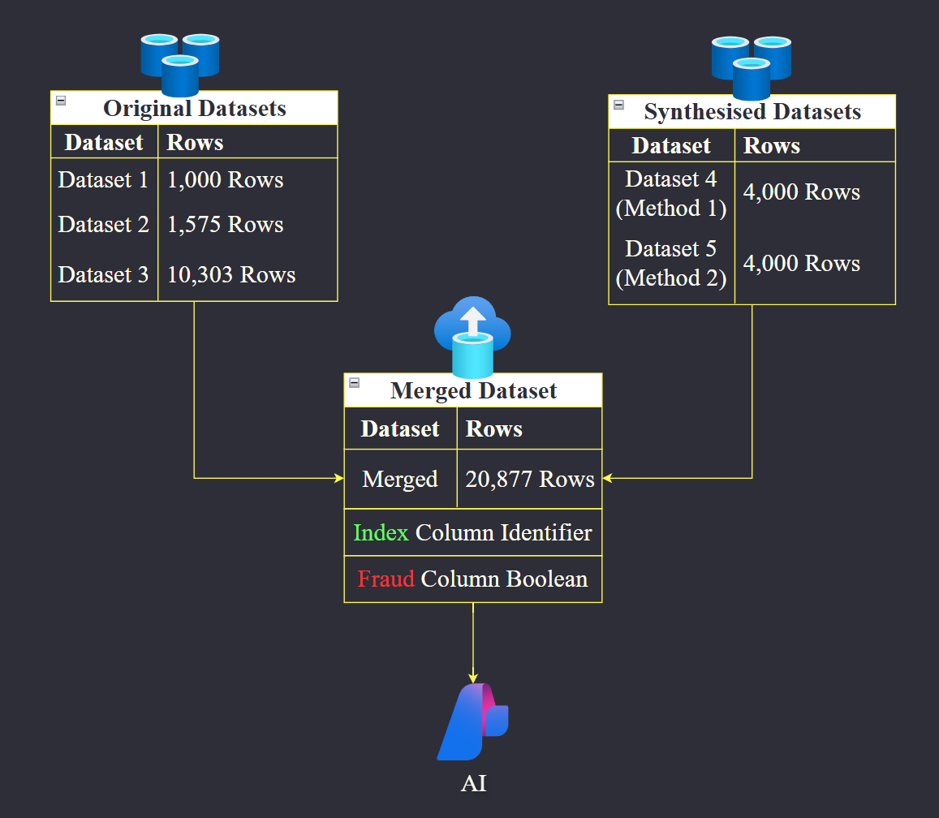
Merging Process - In Detail
Notes:
Synth + merg = 1min 14 seconds

Slide 38
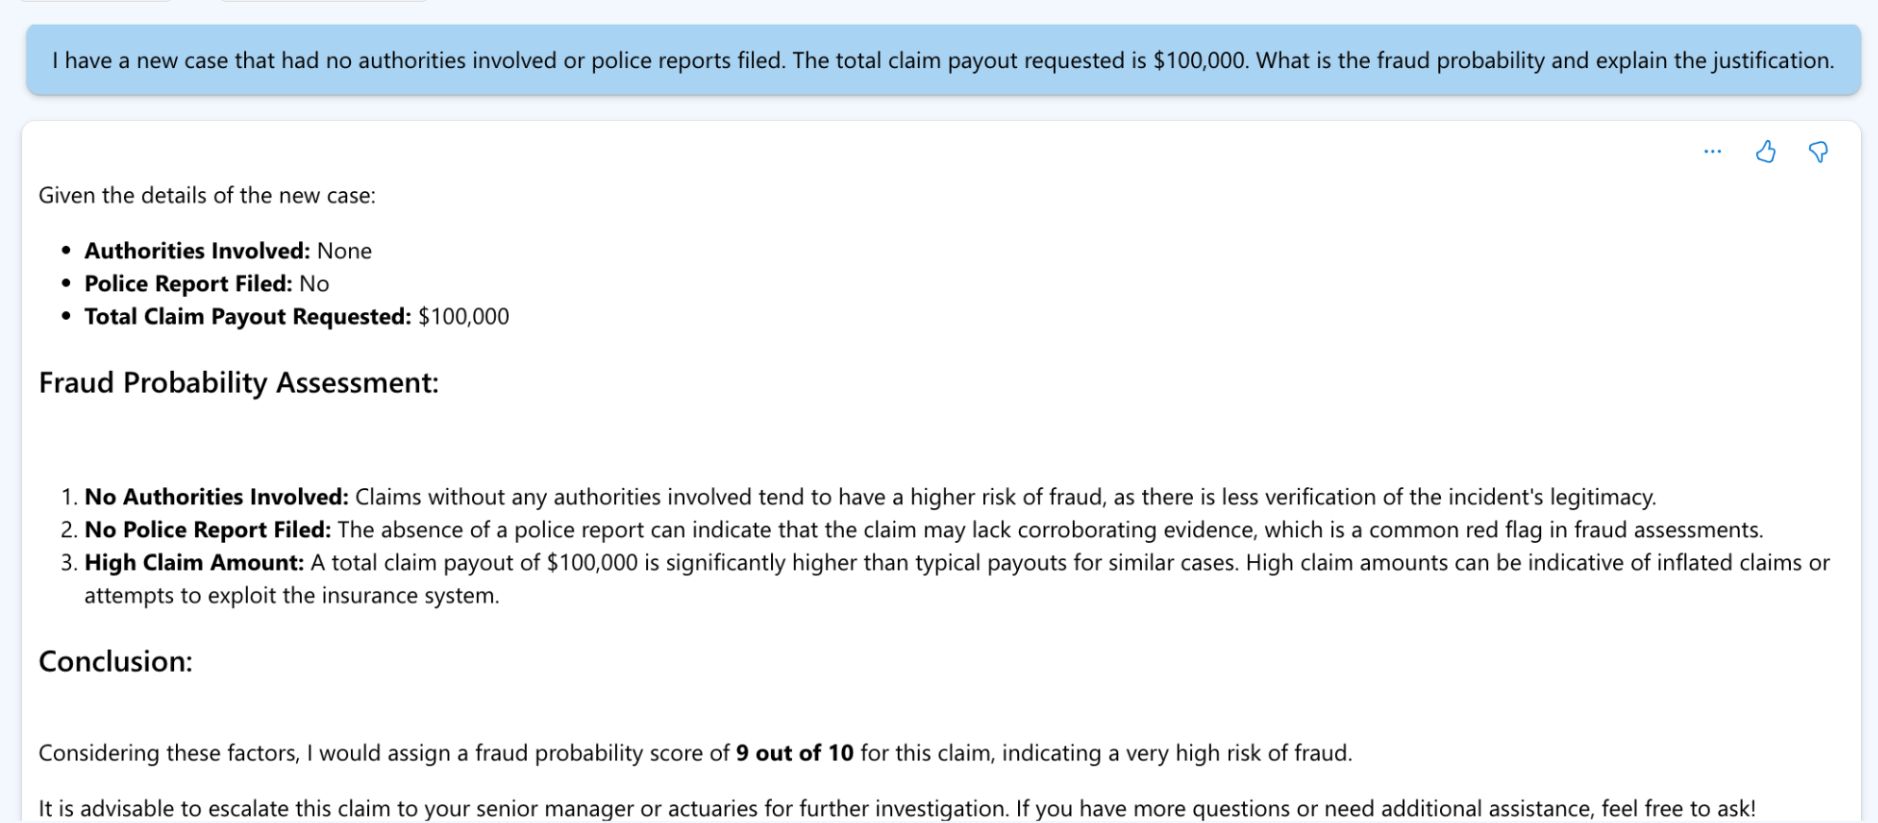
New Data Screenshots
Notes:
Synth + merg = 1min 14 seconds

Slide 39
Transformation (old)
Eugene Sung
Utilising AI out-of-the-box runs into the issue of generic responses.
AI-related Use Case in Insurance Claims
Value For NRMA
FASTER ONBOARDING
CLAIMS MANAGEMENT
FRAUD DETECTION
PRICE OPTIMISATION
Feeding the AI with proprietary and accurate datasets will allow a tailored and enhanced system for NRMA.
The Cosine Similarity formula allows data to be retrieved from PDFs and CSV files.
Tokenization is pivotal in translating the user query into a language that GPT-4o-mini can interpret.
Operating cost of the AI is A$227.79 per month or A$9.54 per day (subject to ± A$5.00 depending on usage).
Across the organization, human talent will focus on higher-value tasks and work with technology in entirely new ways.
• Could answer questions that new hires may have.
• Retrieve definitions, examples, and processes from the NRMA Policy Booklet.
• Uniform platform for processing and settling insurance claims.
• Assign the likelihood of fraud for an insurance claim.
• Explains the factors for how the AI assigned the % of fraud on an insurance claim.
• Enhanced risk assessments.
• Micro-segment or personalised pricing based on non-risk individual behavioral data and market competition analysis.
Use Cases
An average employee spends 11h per-week with the following document management issues.
Source: The State of AI in Document Management
Adobe Oct 22, 2019
With the time reduction, a client can dedicate this time on higher value activities and help reduce employee burnout and avoid repetitive activities.
Evaluation
87%
98%
1.7%
Accuracy Rate
Factual Consistency
Hallucination Rate

Slide 40
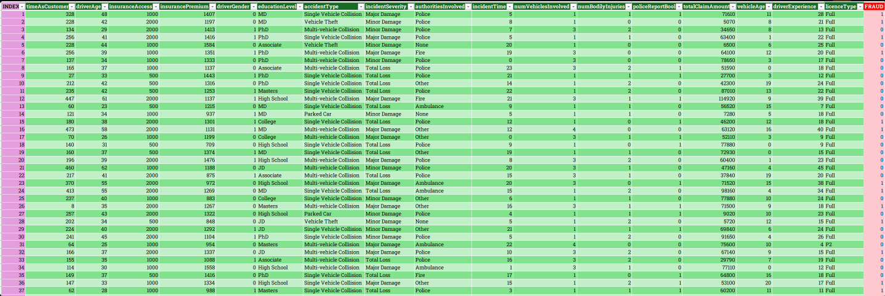
Final Dataset - Rows & Columns
Notes:
Synth + merg = 1min 14 seconds

Slide 41
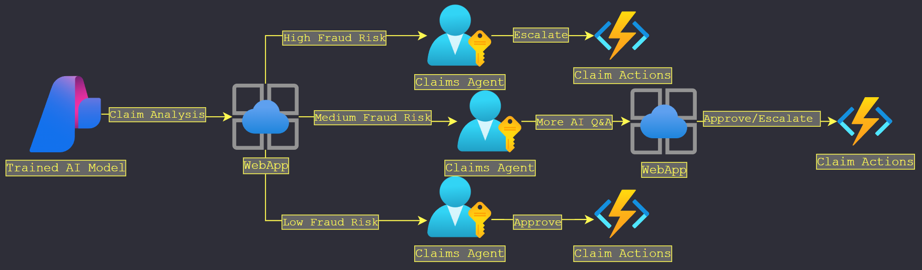
WebApp Claims Processing Detailed
Notes:
Synth + merg = 1min 14 seconds

Slide 42
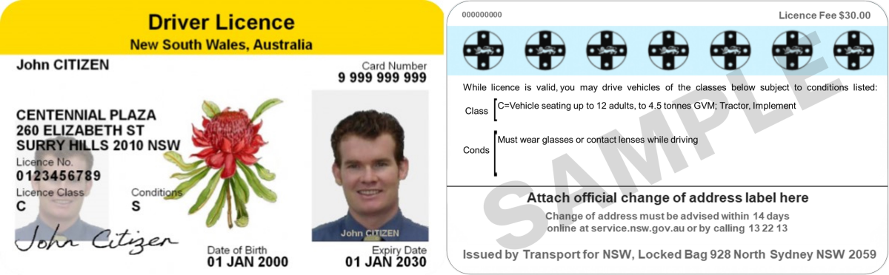
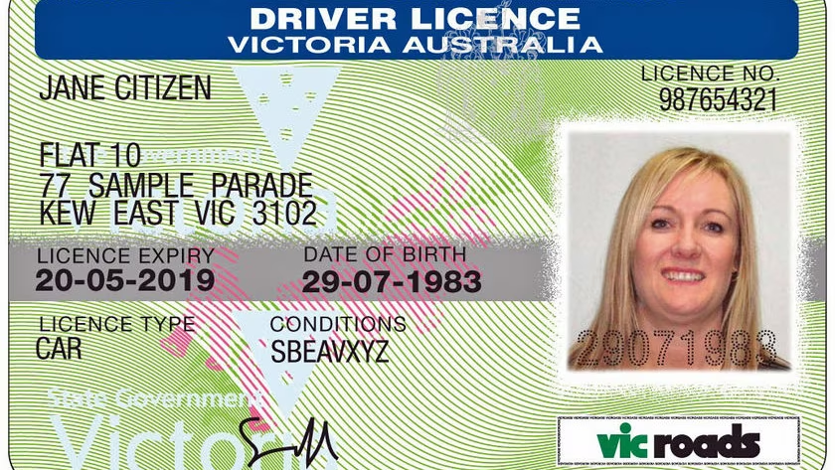
Future Considerations
Driving Innovation in Document Processing Technologies
Intelligent Document Processing
Problem
Technology
Innovation
Era
• Document comes in various formats.
• Driver license:
- NSW, VIC, QLD
- 1980, 1994, 2004
• Optical Character Recognition (OCR) scans images & text to extract data
• Customer send images through
• Large Language Model (LLM) integrated.
• Handle data more dynamically
• Able to flag missing or errors to ask for correction faster
• Big data allows for more robust system • Cloud capabilities handle data at scale
Automates extraction, interpretation & organisation of data at a large scale.
Trial Result
“ Of 3000 claims processed
1636 under 30 minutes
243 under 3 minutes ”
Source: Automating Document Processing To Enhance UX in the Insurance Industry VingBigData Nov 23, 2024
“ An average employee spends 11h per-week with the following document management issues ”
Source: The State of AI in Document Management Adobe Oct 22, 2019
Notes:
While researching for the current system, we found that documents often come in various formats, and even the same document can vary in format across regions and time periods. And it is this specific inconsistency that makes document processing inefficient and prone to error.
Our solution is to build an Intelligent Document Processing (IDP) system powered by OCR and LLMs to automate extraction, interpretation and organisation of data from virtually any document format at a large scale. An example can be seen from Prudential, a major insurance player in VietNam trialed a similar system, processing over 3000 claims via WhatsApp, of that, 240 claims were completed under 3 minutes and over 1600 under 30 minutes.
So we believe that this system will be a valuable extension to the current project, enabling faster data ingestion to reduce time-to-response which will not only enhance customer satisfaction, but also boosting operational efficiency.

